Slide 1
Space planning functionality Examples
JDA
Dennis Smits

Slide 2
Why this slides
The purpose of the slides is to give real life examples of how the tools can be used to inspire customers by implementing the software in their own work processes.
This document isn’t a full overview of all possible ways of using the software.
This document does not replace any of the existing official training materials.
Therefore this file should not be shared with customers, but associates can use the slides in workshops or presentations.
This document should be a dynamic document. New interesting ways of using the software should be added.
Copyright © 2018 JDA Software Group, Inc. Confidential

Slide 3
Planogram explorer Deciding on which products need to be added or removed
The planogram explorer is a powerful tool that can be customized to help a Space planner.
Important questions for a Space planner when updating a planogram are:
Which products do I need to add to the planogram?
Which products do I need to remove from the planogram?
When JDA Assortment Optimization is used this tool could provide the Space planner with relevant information.
The next slides show the usage of the planogram explorer without the usage of JDA Assortment Optimization.
Copyright © 2018 JDA Software Group, Inc. Confidential

Slide 4
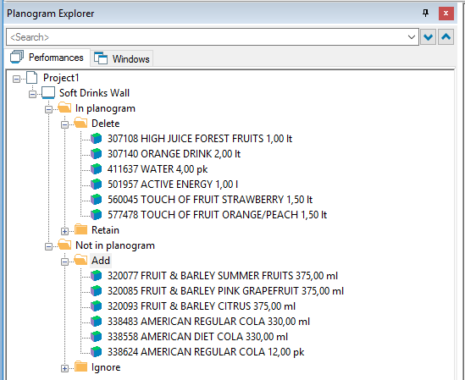
Planogram explorer Deciding on which products need to be added or removed
One of the customers had a decision making process in place where the buyers did make decisions by filling in an Excel product list.
This Excel list is imported by the Space planner setting a flag field.
Flag has not been set.
Currently in the POG = DELETE
Not in the POG = IGNORE
Flag has been set.
Currently in the POG = RETAIN
Not in the POG = ADD
Copyright © 2018 JDA Software Group, Inc. Confidential

Slide 5
Planogram explorer Deciding on which products need to be added or removed
At another customer the products needed for a pog are filtered out of the total product list based on rules.
Products should be active when the pog is going live.
Start date on or before the day of planogram go live.
End date should be after the planogram go live.
A custom planogram field “planned live date” was used by the Space planner to set the date to compare product dates with.
Only products that have a start date after the previous planogram update but on or before the go live of this planogram should be shown as “new” for the Space Planner.
A custom planogram field (update Interval) was calculated at this customer to be able to set the “new” products correctly in the planogram explorer.
Copyright © 2018 JDA Software Group, Inc. Confidential

Slide 6
Planogram explorer Deciding on which products need to be added or removed
Custom fields for both promotional products and promotional planograms were used.
Promotional planograms should only contain promo products.
Non promotional planograms should only contain non promo products.
Dummy products are shown within a separate node in the Planogram explorer.
The options mentioned here are just examples to show that the Planogram explorer could be used to filter and sort products in useful nodes.
Only limit is the maximum number of signs that can be used (<1000).
Copyright © 2018 JDA Software Group, Inc. Confidential

Slide 7
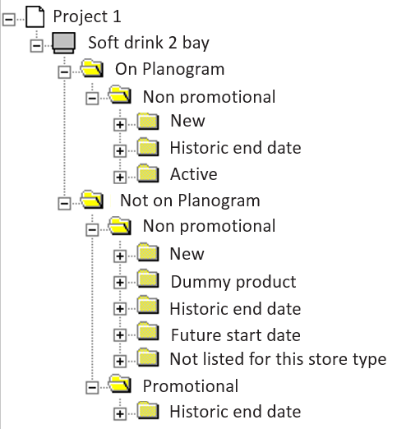
Planogram explorer Deciding on which products need to be added or removed
On the left an example of a Planogram explorer view.
In the “on planogram” folder the most important node to look at is probably “Historic end date”.
Those can probably be deleted from the planogram.
In the “not on the planogram” folder the “new” and “dummy product” nodes are most interesting.
Those are potential adds for the planogram.
Copyright © 2018 JDA Software Group, Inc. Confidential

Slide 8
Highlight: Managing available space
This highlight can be used to maximize the shelf usage by adding or deleting facings where possible or needed.
Positions are shown in red when a fixture is overfilled.
Positions are shown in green when it is possible to add a facing.
The highlight is using the product orientation as used on the planogram.
This highlight can be found at the EMEA team site.
JDA - Managing available space.PSH
This highlight is only using standard fields and doesn’t need customization to be used for a customer.
An example is shown on the next slide.
Copyright © 2018 JDA Software Group, Inc. Confidential

Slide 9
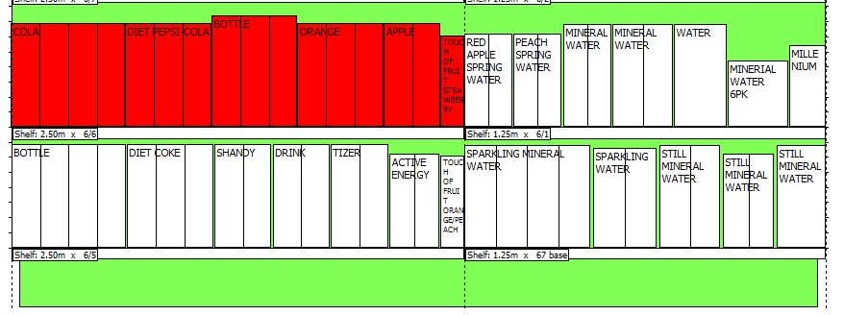
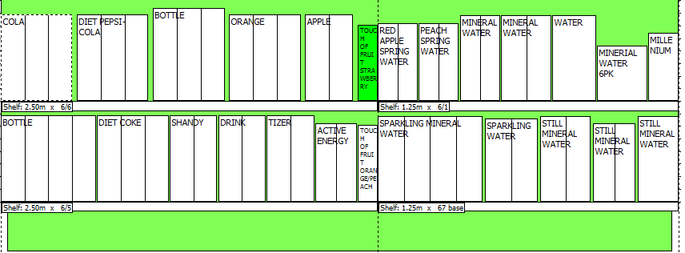
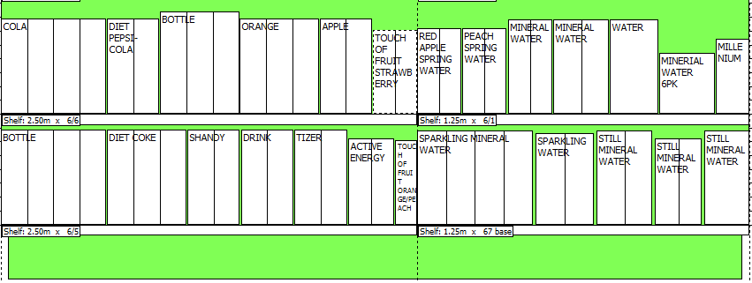
Highlight: Managing available space Example
1) The fixture on the left is overfilled with 0,4 cm. Possible solutions:
You could combine shelves.
You could move a product to another location.
You could reduce facings for one of the red products.
2) Cola facings are reduced from 4 to 3 facings.
The fixture is no longer overfilled.
3) The “Touch of fruit strawberry” product now shows in green.
Adding a facing is possible.
4) Now the fixture space is used as efficient as possible for this shelf.
Copyright © 2018 JDA Software Group, Inc. Confidential

Slide 10
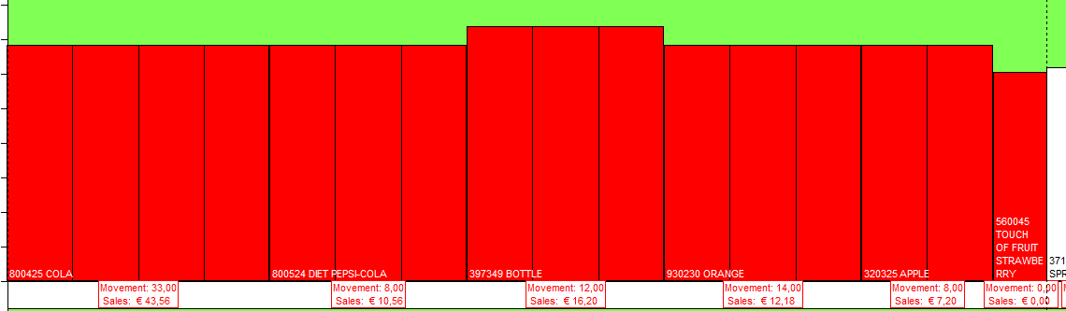
Highlight: Managing available space Combining with performance data
In the example on the previous slide we reduced facings for “Cola” without knowing if this is the best product to reduce the facings on.
To help reducing (or increasing) facings for the correct product a label could be used with some key information.
In this example Unit Movement and Sales on performance level are shown to help making the correct decision.
Copyright © 2018 JDA Software Group, Inc. Confidential

Slide 11
Highlight: Managing minimum stock Minimum display quantity
Another way of managing facings is based on the preferred minimum display quantity (MDQ).
Some examples of logistic rules:
Case on shelf > 1,25 cases.
Minimum based on a fixed number.
Minimum based on a % of the unit movement.
An example is shown on the next page.
Facings for green products can be reduced.
Red products do need more facings.
A supporting highlight was created for this customer to show the number of facings that can be removed or need to be added.
Copyright © 2018 JDA Software Group, Inc. Confidential

Slide 12
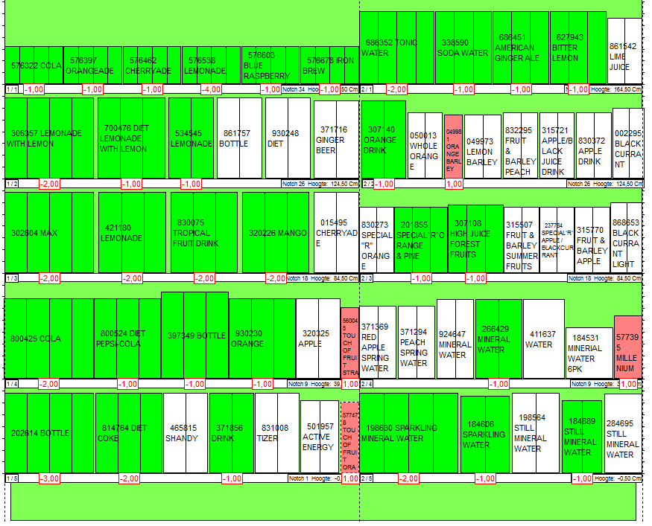
Highlight: Managing minimum stock Based on logistic rules (e.g. Case multiple >1,25)
The facings for green products can be reduced.
For example 576322 Cola can be reduced with 1 facing without causing problems with the case multiple.
The red products should get extra facings.
For example 577395 Millenium does need 1 extra facing to satisfy the >1,25 rule.
Copyright © 2018 JDA Software Group, Inc. Confidential

